Slide 1
Decision Tree決策樹

Slide 2
Decision Tree : An Example
Training data set: Buys_computer
The data set follows an example of Quinlan’s ID3 (Playing Tennis)
Resulting tree:
age?
<=30
overcast
>40
31..40
student?
yes
credit rating?
no
yes
excellent
fair
no
yes
no
yes

Slide 3
Algorithm for Decision Tree Induction
Basic algorithm (a greedy algorithm)
Tree is constructed in a top-down recursive divide-and-conquer manner
At start, all the training examples are at the root
Attributes are categorical (if continuous-valued, they are discretized in advance)
Examples are partitioned recursively based on selected attributes
Test attributes are selected on the basis of a heuristic or statistical measure (e.g., information gain)
Conditions for stopping partitioning
All samples for a given node belong to the same class
There are no remaining attributes for further partitioning – majority voting is employed for classifying the leaf
There are no samples left

Slide 4
三大主題
特征選擇
決策樹的生成
決策樹的剪枝
C5.0
 | ID3 | C4.5 | CART
特征選擇 | Information gain | Gain ratio | Gini index
John Ross Quinlan
Iterative Dichotomiser 3 疊代二叉樹3代
https://en.wikipedia.org/wiki/ID3_algorithm
C4.5
https://en.wikipedia.org/wiki/C4.5_algorithm
CART (Classification And Regression Tree)
https://en.wikipedia.org/wiki/Decision_tree_learning

Slide 5
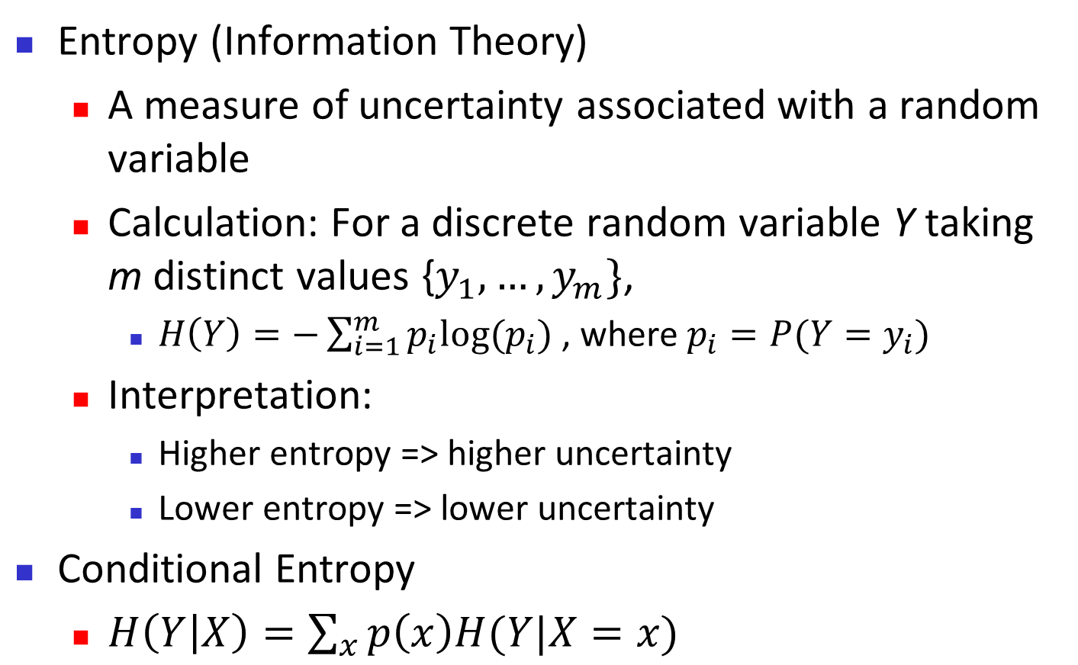
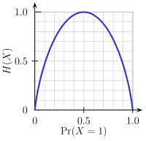
Brief Review of Entropy
m = 2

Slide 6
Attribute Selection Measure: Information Gain (ID3/C4.5)
Select the attribute with the highest information gain
Let p_{i} be the probability that an arbitrary tuple in D belongs to class C_{i}, estimated by |C_{i, D}|/|D|
Expected information (entropy) needed to classify a tuple in D:
Information needed (after using A to split D into v partitions) to classify D:
Information gained by branching on attribute A
Notes:
I : the expected information needed to classify a given sample
E (entropy) : expected information based on the partitioning into subsets by A

Slide 7
Attribute Selection: Information Gain
Class P: buys_computer = “yes”
Class N: buys_computer = “no”
means “age <=30” has 5 out of 14 samples, with 2 yes’es and 3 no’s. Hence
Similarly,

Slide 8
Computing Information-Gain for Continuous-Valued Attributes
Let attribute A be a continuous-valued attribute
Must determine the best split point for A
Sort the value A in increasing order
Typically, the midpoint between each pair of adjacent values is considered as a possible split point
(a_{i}+a_{i+1})/2 is the midpoint between the values of a_{i} and a_{i+1}
The point with the minimum expected information requirement for A is selected as the split-point for A
Split:
D1 is the set of tuples in D satisfying A ≤ split-point, and D2 is the set of tuples in D satisfying A > split-point

Slide 9
Gain Ratio for Attribute Selection (C4.5)
Information gain measure is biased towards attributes with a large number of values
C4.5 (a successor of ID3) uses gain ratio to overcome the problem (normalization to information gain)
GainRatio(A) = Gain(A)/SplitInfo(A)
Ex.
gain_ratio(income) = 0.029/1.557 = 0.019
The attribute with the maximum gain ratio is selected as the splitting attribute

Slide 10
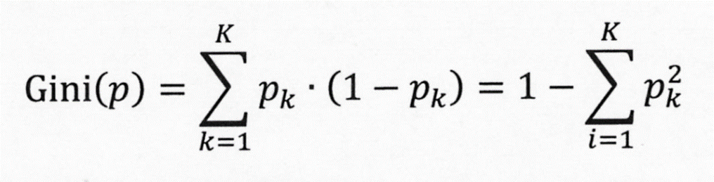

Slide 11
Gini Index (CART, IBM IntelligentMiner)
If a data set D contains examples from n classes, gini index, gini(D) is defined as
where p_{j} is the relative frequency of class j in D
If a data set D is split on A into two subsets D₁ and D₂, the gini index gini(D) is defined as
Reduction in Impurity:
The attribute provides the smallest gini_{split}(D) (or the largest reduction in impurity) is chosen to split the node (need to enumerate all the possible splitting points for each attribute)

Slide 12
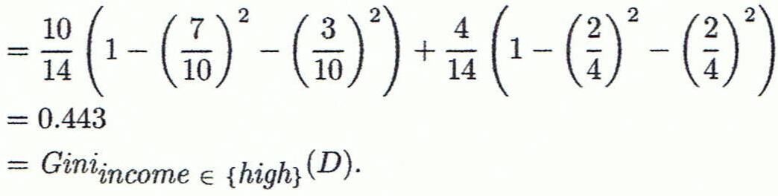
Computation of Gini Index
Ex. D has 9 tuples in buys_computer = “yes” and 5 in “no”
Suppose the attribute income partitions D into 10 in D₁: {low, medium} and 4 in D₂
Gini_{{low,high}} is 0.458; Gini_{{medium,high}} is 0.450. Thus, split on the {low,medium} (and {high}) since it has the lowest Gini index
All attributes are assumed continuous-valued
May need other tools, e.g., clustering, to get the possible split values
Can be modified for categorical attributes

Slide 13
Comparing Attribute Selection Measures
The three measures, in general, return good results but
Information gain:
biased towards multivalued attributes
Gain ratio:
tends to prefer unbalanced splits in which one partition is much smaller than the others
Gini index:
biased to multivalued attributes
has difficulty when # of classes is large
tends to favor tests that result in equal-sized partitions and purity in both partitions

Slide 14
Other Attribute Selection Measures
CHAID: a popular decision tree algorithm, measure based on χ² test for independence
C-SEP: performs better than info. gain and gini index in certain cases
G-statistic: has a close approximation to χ² distribution
MDL (Minimal Description Length) principle (i.e., the simplest solution is preferred):
The best tree as the one that requires the fewest # of bits to both (1) encode the tree, and (2) encode the exceptions to the tree
Multivariate splits (partition based on multiple variable combinations)
CART: finds multivariate splits based on a linear comb. of attrs.
Which attribute selection measure is the best?
Most give good results, none is significantly superior than others

Slide 15
ID3算法
Calculate the entropy of every attribute {\displaystyle a}a of the data set {\displaystyle S}S.
Partition ("split") the set {\displaystyle S}S into subsets using the attribute for which the resulting entropy after splitting is minimized; or, equivalently, information gain is maximum
Make a decision tree node containing that attribute.
Recurse on subsets using the remaining attributes.
越是小型的決策樹越優於大的決策樹（簡單理論）。
儘管如此，該算法也不是總是生成最小的樹形結構。
是一個啟發式算法

Slide 16
C4.5算法
檢查上述基本情況
對於每個特徵a，計算劃分a的信息增益
記a_best為最高信息增益的特徵
創建一個在a_best上劃分的決策節點
使用劃分後的樣本創建作為當前決策節點的子節點，並在這些子節點上遞歸地處理

Slide 17
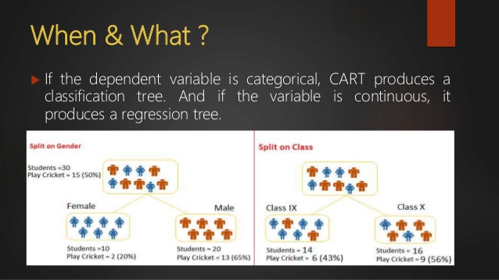
CART – Classification & Regression Trees
https://www.slideshare.net/hemantchetwani/cart-classification-regression-trees

Slide 18
CART (Classification And Regression Tree)
Breiman, Leo; Friedman, J. H., Olshen, R. A., & Stone, C. J. Classification and regression trees. Monterey, CA: Wadsworth & Brooks/Cole Advanced Books & Software. 1984. ISBN 978-0-412-04841-8.
Decision trees are formed by a collection of rules based on variables in the modeling data set:
Rules based on variables' values are selected to get the best split to differentiate observations based on the dependent variable
Once a rule is selected and splits a node into two, the same process is applied to each "child" node (i.e. it is a recursive procedure)
Splitting stops when CART detects no further gain can be made, or some pre-set stopping rules are met. (Alternatively, the data are split as much as possible and then the tree is later pruned.)
Each branch of the tree ends in a terminal node.
Each observation falls into one and exactly one terminal node, and each terminal node is uniquely defined by a set of rules.

Slide 19
Overfitting and Tree Pruning(樹支修剪)
Overfitting: An induced tree may overfit the training data
Too many branches, some may reflect anomalies due to noise or outliers
Poor accuracy for unseen samples
Two approaches to avoid overfitting 樹支修剪的兩種方法
Prepruning: Halt tree construction early ̵ do not split a node if this would result in the goodness measure falling below a threshold
Difficult to choose an appropriate threshold
Postpruning: Remove branches from a “fully grown” tree—get a sequence of progressively pruned trees
Use a set of data different from the training data to decide which is the “best pruned tree”

Slide 20
Enhancements to Basic Decision Tree Induction 基本決策樹的加強版
Allow for continuous-valued attributes
Dynamically define new discrete-valued attributes that partition the continuous attribute value into a discrete set of intervals
Handle missing attribute values
Assign the most common value of the attribute
Assign probability to each of the possible values
Attribute construction
Create new attributes based on existing ones that are sparsely represented
This reduces fragmentation, repetition, and replication

Slide 21
Sklearn
Decision Tree

Slide 22
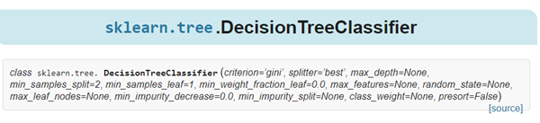
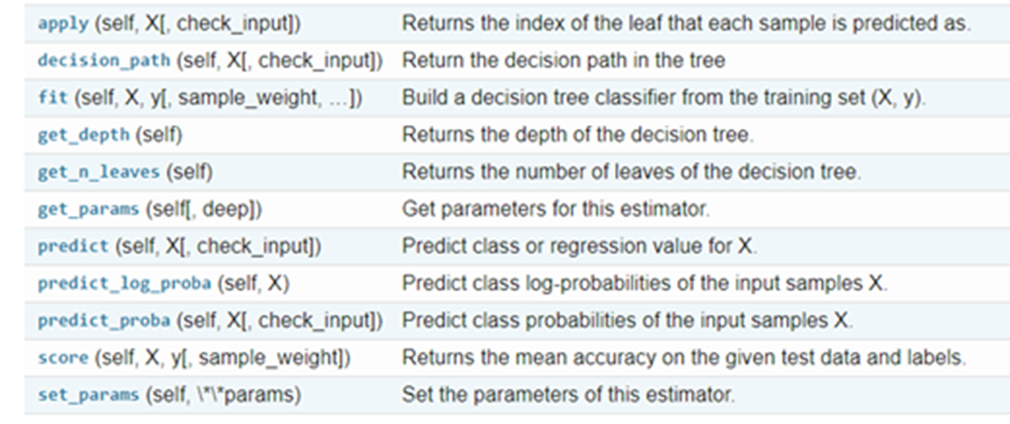
Parameters 參數
Attributes 屬性
https://scikit-learn.org/stable/modules/generated/sklearn.tree.DecisionTreeClassifier.html
Methods
方法
L. Breiman, J. Friedman, R. Olshen, and C. Stone, “Classification and Regression Trees”, Wadsworth, Belmont, CA, 1984.

Slide 23
class sklearn.tree.DecisionTreeClassifier(
criterion=’gini’,
splitter=’best’,
max_depth=None,
min_samples_split=2,
min_samples_leaf=1,
min_weight_fraction_leaf=0.0,
max_features=None,
random_state=None,
max_leaf_nodes=None,
min_impurity_decrease=0.0,
min_impurity_split=None,
class_weight=None,
presort=False)
criterion : string, optional (default=”gini”)
The function to measure the quality of a split. Supported criteria are “gini” for the Gini impurity and “entropy” for the information gain.
splitter : string, optional (default=”best”)
The strategy used to choose the split at each node. Supported strategies are “best” to choose the best split and “random” to choose the best random split.

Slide 24
DEMO

Slide 25
from pandas import read_csv
from sklearn.model_selection import KFold
from sklearn.model_selection import cross_val_score
from sklearn.tree import DecisionTreeClassifier
# 導入數據
filename = 'pima_data.csv'
names = ['preg', 'plas', 'pres', 'skin', 'test', 'mass', 'pedi', 'age', 'class']
data = read_csv(filename, names=names)
# 將資料分為輸入資料和輸出結果
array = data.values
X = array[:, 0:8]
Y = array[:, 8]

Slide 26
num_folds = 10
seed = 7
kfold = KFold(n_splits=num_folds, random_state=seed)
model = DecisionTreeClassifier()
result = cross_val_score(model, X, Y, cv=kfold)
print(result.mean())
0.6886876281613123

